Slide 1
Introduction to digital transcription
s.b.albert@lboro.ac.uk /@saul

Slide 2
Suggested timings (if you use these slides)
Approaches to digital transcription (10m)
Getting started with CLAN (25m + 5m break)
More advanced work with CLAN (25m + 5m break)
Getting started with ELAN (25m + 10m break)
Using CLAN and ELAN together (40m + 5m break)
Future tools and directions for digital transcription
Questions/follow-ups (10m)

Slide 3
Outline
Approaches to digital transcription
Getting started with CLAN
More advanced work with CLAN
Getting started with ELAN
Using CLAN and ELAN together
Future tools and directions for digital transcription
Questions/follow-ups

Slide 4
Major paradigms for digital transcription
Turn-by-turn editors
CLAN / TranscriberAG / FOLKER (specialist tools)
Inqscribe / Transana (more generic tools)
Simple: Word processor + video player + footpedal/hotkeys
Partition editors
ELAN / ExMaralda (especially for GAT2 users)
Max QDA/NVIVO
Simple: Graph paper + video player + pencil
NB: All research software is buggy. Backup your work!

Slide 5
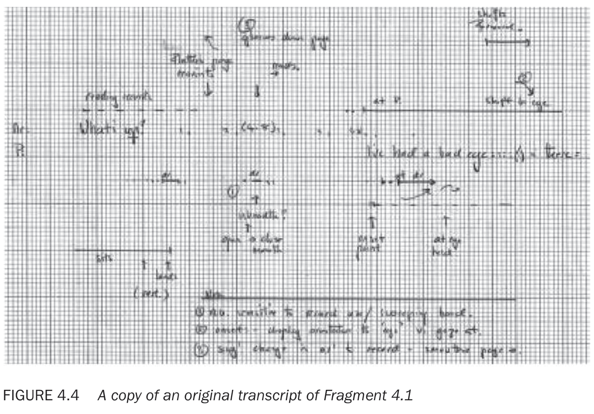
(Heath et al, 2010 p. 72)
Notes:
Heath, C., Hindmarsh, J., & Luff, P. (2010). Video in qualitative research: Analysing social interaction in everyday life. Sage Publications.

Slide 6
Why use digital transcription tools anyway?
Individual benefits
Synchronizing audio/video with transcripts for ease of use
Interoperability with other formats/tools & associated sub-disciplines
Future-proofing your transcriptions using convertible formats
Field-wide benefits
Incentivizing software developers to take EM/CA into account
Standardizing and streamlining the process of learning to transcribe
Growing the pool of community-wide digital transcription resources
Notes:
TEI

Slide 7
Is your computer set up and ready?
Download sample files: https://saulalbert.net/digital-transcription/ and unzip them onto your desktop
Make sure you have CLAN installed
http://dali.talkbank.org/clan/
Install CAfont
http://dali.talkbank.org/clan/CAfont.otf
Make sure you have ELAN installed
https://tla.mpi.nl/tools/tla-tools/elan/download/
Have you opened test.cha and test.eaf and tried playing them?
Notes:
If anyone isn’t set up yet, we can take a quick break now and I can help them get it organized.

Slide 8
Outline
Approaches to digital transcription
Getting started with CLAN
More advanced work with CLAN
Getting started with ELAN
Using CLAN and ELAN together
Future tools and directions for digital transcription
Questions/follow-ups

Slide 9
Ex1: CHAT format and its file headers
Familiarize yourself with a CLAN file:
CHAT is the native file format of CLAN, CA users don’t use ‘strict’ CHAT
Open the sample Game_Night.cha file, look at the ‘headers’
Open newfile.cha in CLAN and copy the contents across line by line.
@Participants line (structured as code / name / role)
@Options (relevant for us are CA / CA unicode / heritage)
@ID lines include demographic / metadata
(@ID: language|corpus|code|age|sex|group|SES|role|education|custom|)
@Media (show where the audio/video is – NB: can be in a ‘media’ subfolder)
Speaker tiers (the important bit)

Slide 10
Common teething problems
Making sense of @Participants and @ID lines
You can generate @ID tiers from your @Participants list
You can use keyboard shortcuts to insert participant codes (ctl+1/2/3)
Font & presentation problems
You should use the CAfont (http://dali.talkbank.org/clan/CAfont.otf)
When you use @Options CA / heritage, CAfont is auto-selected
Try closing and reopening your newfile.cha, it should be in CAfont now.

Slide 11
Ex 2a: Navigating/playing transcripts in CLAN
Open Game_Night.cha in CLAN
Make sure that line numbers are showing (in the ‘mode’ menu)
Place your cursor on line 17 and press {esc-8} – it should play through
Put your cursor on line 25 and press F9 – it should play once
Press ‘ctl’ (win)/ ‘command’ (mac) & click to replay the current line
Press esc-0 or use the ‘mode’ menu to go to ‘sonic mode’
Select any part of the audio to play it. ctl/cmd click to replay it
Double click on any line that ends with a circular bullet.

Slide 12
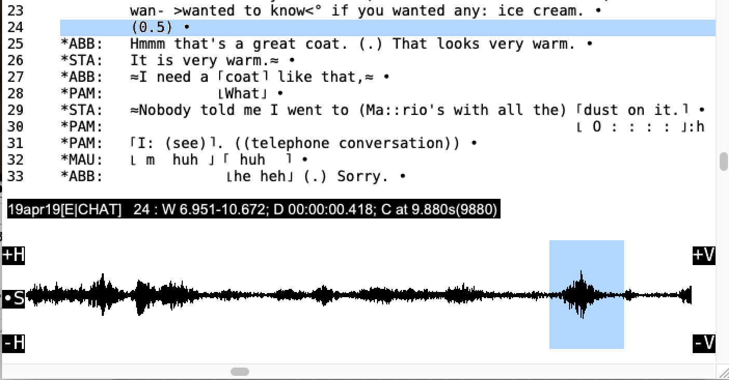
Ex 2b: Using the CLAN audio window
Try selecting a bit of silence, then add a bullet. You can ‘time’ this silence
When you’ve got some audio selected, click on the black info bar above the waveform. Click a few times to change the information displayed.
Try pressing the +H and –H keys at the sides of the audio window
Now try pressing the +V and –V keys
NB: omit 0.1-0.2 ‘beats’ if using machine timing for longer gaps (Hepburn & Bolden 2017 p. 27)
Notes:
W indicates the time displayed in the Window; D the Duration of what has been selected; C indicates the placement of the Cursor
“Student question: I am using software to measure gaps and pauses; how Jong
should a 'normal transition' or 'beat of silence' be?
Answer: There is some evidence to suggest that gaps can be anything from 0.05 to
0.25 seconds depending largely on the pace of the preceding talk (Stivers et al.,
2009). Any shorter than 0.05 and the transition space sounds 'compressed', i.e.
latched or jump-started; any longer than (typically) 0.2 and it sounds 'stretched' .
The upshot is that if you wan110 objectively measure the time , ,nake sure 10 omit the
beat of silence 1ha1 indicates a normal transition, and subtract around 0.1-0.2 from
longer gaps, so, for example, an objective measure of 0.3 could become(.); 0.4
becomes (0.2); 0.6 is (0.4) and so on.”

Slide 13
Ex 3: Starting a new transcript from scratch
Open newfile.cha
Fill in the header lines for the media file you are going to transcribe
Hit ‘update’ in the ‘Tiers’ menu to check your keyboard shortcuts
Hit ‘ID Headers’ if you want to enter demographic/corpus data
Go into ‘sonic mode’ (esc-0 or via the ‘mode’ menu)
Use your cursor to select the first turn you can hear in the waveform
Use control/command 1/2/3 etc. to attribute the turn & transcribe it
At the end of the turn press ‘ctl/cmd i’ to place an audio ‘bullet’

Slide 14
Ex 4: Linking a/v data to transcript lines
Open Game_Night-unlinked.cha
Enter ‘sonic mode’ and select the audio corresponding to line 17
Place an ‘audio bullet’ at the end of line 17 using ‘cmd/ctl i’
Continue to line 33 (use the shift key to modify your audio selection)
When you’ve finished, press esc-a – to ‘expand bullets’ or use the ‘expand bullets’ menu item. These are the millisecond start/end times ‘hidden’ by CLAN in each bullet. Press esc-a again to hide/show them.

Slide 15
Outline
Approaches to digital transcription
Getting started with CLAN
More advanced work with CLAN
Getting started with ELAN
Using CLAN and ELAN together
Future tools and directions for digital transcription
Questions/follow-ups

Slide 16
Ex 5: Alternative (rough) linking approach
Open Game_Night-unlinked.cha (remove bullets if you saved them)
Go to Edit/Select F5 option and choose ‘bullet on every line’
Place your cursor anywhere on line 17
Get ready to press the space bar at the end of the line, now press F5!
Keep pressing the space bar until there is a bullet at the end of every line. This is a rough, quick way to link a non-digital transcript to audio/visual data.
Notes:
NB: make sure you put a bullet on every line

Slide 17
Ex 6a: CHAT ‘Special characters’ & overlaps
CLAN uses ‘Unicode’ symbols that are particularly useful for CA transcripts:
Using Unicode symbols can make your transcripts computationally usable
E.g., CLAN’s Unicode overlap markers enable automated overlap alignment
Open the ‘special characters’ window to see some CLAN Unicode symbols – you do not have to use all of these but some of them are very useful.
Try creating some Unicode overlap markers by typing F1 +square braces for the top line of the overlap, and F1 +curly braces for the bottom line. Make sure to add spaces within the overlap markers to match to/bottom lines
Notes:
Digital transcription always involves compromises between computational legibility and faithfulness to traditional Jeffersonian transcription standards.
We will show you why automated overlap alignment is useful later on.

Slide 18
Ex 6b: CLAN’s brilliant unicode underlines
CLAN’s unicode underlines let you paste transcripts into plain text without losing your precious underlines in the publication process.
Put the cursor ahead of any character, then press F2 underscore
Unicode underlines allow easy migration into other text editors
Try copying underlined text from Word into CLAN or any other plain text editor e.g., Notepad (Win) or TextEdit in plain text mode (Mac)
Now try copying/pasting F2-underline text from CLAN. It should work.

Slide 19
Outline
Approaches to digital transcription
Getting started with CLAN
More advanced work with CLAN
Getting started with ELAN
Using CLAN and ELAN together
Future tools and directions for digital transcription
Questions/follow-ups

Slide 20
Ex 7: Getting started with ELAN
Open Game_Night.mp4 in ELAN (file/open or drag it into the window)
Make sure you are in ‘Options/annotation mode’.
Try out the play/frame/1 second controls under the video window
Click and drag on the default tier to highlight an embodied action.
Double click on the highlighted section to add an annotation.
Click away to deselect the area, click the annotation to re-select it.
Press the ‘selection’ play button to play the selected area
Go to ‘Tier/Add New Tier’ to add additional tiers for each speaker

Slide 21
Ex 8: Synchronizing media files in ELAN
Go to ‘Options/Media Synchronization Mode’
Go to ‘Edit/Linked Files/’ and add Game_Night-zoomed.mp4
Now you can (un/re)synchronize the files by playing Player 1 or 2
Go to ‘Edit/Linked Files/’ and add Game_Night-clanw.wav
Now you can (un/re)synchronize the files by playing Player 1 / 2 / 3
Notes:
Absolute Offsets: for every video its own timing is being shown.
Relative Offsets: the video of player 1 is appointed to be the “master”, i.e. the time position of the other videos will be determined as starting point of this file, which starts at 00:00:00.000.

Slide 22
Ex 9: Using multimodal tiers & annotations
Add some tiers for Abbie’s talk (call it ABB), Terry’s talk (TER) etc. & transcribe a few lines of talk for each speaker.
Add a separate ‘gaze’ or a ‘gesture’ tier for Abbie called gaz@ABB or ges@MAU etc. Once you’ve created them, drag to re-order your tiers.
Add some embodied details on these tiers, creating annotations that correspond to the onset, sustain and retraction of the movement.
Resize annotations by selecting an area of timeline, holding shift to increase/decrease the selection & pressing ctl/cmd + the return key.
Notes:
You are now transcribing! You can do this with any number of speakers, modalities and resources.

Slide 23
Outline
Approaches to digital transcription
Getting started with CLAN
More advanced work with CLAN
Getting started with ELAN
Using CLAN and ELAN together
Future tools and directions for digital transcription
Questions/follow-ups

Slide 24
Why & how to combine these digital tools
Each one is good for different things:
CLAN is good for turn-by-turn talk and relatively fast transcription
ELAN is good for multi-party activities, visible actions and accurate timing
Combining tools allows us to focus on & describe different orders of action
We can combine these tools systematically:
Use turn-by-turn editors like CLAN to create a starting point
Consider making a verbatim version followed then a more detailed Jeffersonian version
Focus on timing accuracy and multi-activity using partition-editors like ELAN
Work with ELAN to help create a more accurate, polished, multimodal transcript

Slide 25
Some tips for transcribing with CLAN for ELAN
If the turn is very long and covers multiple lines, you can break up the line into shorter sections with audio bullets on the end of every line.
If you are transcribing lots of overlapping talk that include long turns, try to break it up into multiple lines, so each each line only includes one (long), or at most two (shorter) overlapping segments.
Before converting files from CLAN to ELAN, mark inter-turn gaps with a temporary speaker ID e.g., “*SIL: “, which you can remove later.
In CLAN, search/replace all instances of: “+tab (“, with “*SIL: +tab (“
later, you can reverse this process by replacing ”*SIL: +tab (“ with “+tab”.

Slide 26
Some tips for transcribing with ELAN for CLAN
If you are transcribing lots of overlapping talk that include long turns, try to create multiple annotations so that each annotation only has one, or at most two overlapping segments. Try to do this in CLAN too.
When annotating silent actions, you can either follow Mondada’s conventions by putting in e.g., (1.0) or a ((description)) in the person’s ‘talk’ tier corresponding to your annotation in their gesture/gaze tier
This is so that CLAN can later render your transcript in a ‘line-by-line’ format

Slide 27
Ex 10: Adding visible actions in CLAN for ELAN
In CLAN, you can do ((Jeffersonian style descriptions)) to start with and add multiple time-synced %ges (gesture) or %gaz (gaze) ‘tiers’:
Add a new line under a speaker’s turn labelled %ges or %gaz, describing their action, then select the corresponding timeline area & add a timing bullet.
To annotate silent – but visible – actions and e.g., bodily movements, use a ((description)) or (0.1) time reference in a speaker tier above the gesture tier.
You can make up extra tiers using the ‘%’ sign e.g., %com (comment).
Show/hide each tier type by pressing {esc-4} or ‘show/hide tiers’.
Save your Game_night.cha file with the new %ges, %com, or %gaz tiers
NB: Make sure you’ve added temporary *SIL: ids for lines with gaps

Slide 28
Ex 11: Moving from CLAN to ELAN
Open open the ‘command’ window in CLAN
Type ‘chat2elan +e.mp4’ (+e.mp4 tells CHAT to look for an mp4/mov/wav file)
click ‘file in’ and locate Game_Night.cha, add it, (an ‘@’ appears), click ‘run’
You should now have a file called Game_Night.c2elan.eaf. Open it in ELAN
You can now refine your CLAN %ges or %gaz tiers in ELAN
When making tiers in ELAN use CLAN naming style e.g., ges@MAU / ges@TER
When creating a new tier, assign its ‘parent tier’ to the speaker e.g., MAU/TER
You can re-organize the order of tiers in your ELAN file for visual coherence
Refine/add new tier annotations using ELAN’s more accurate timeline
Note that you can only add an annotation to a ‘child’ tier if you have annotated something happening e.g., talk or a ((description)) in its parent tier
Notes:
10:45-11:25

Slide 29
Ex 12: Moving from ELAN back to CLAN
Convert your new eaf file back to .cha in the CLAN command window:
Type ‘elan2chat’, ‘file in’ and locate the Game_Night.c2elan.eaf file
You will need to untick ‘show only .cha and .cex files’ to see your .eaf file
Click ‘run’ – you should now have a file called Game_Night.c2elan.elan.cha
Notice that your indents are now misaligned (the conversion deletes spaces)
Use the INDENT command to automatically re-align your indents
Open the ‘commands’ window and type INDENT
The ‘File in’ box should become clickable – click it and select your file.
An @ symbol should appear in the command window. Click ‘Run’.
Check alignments in your new file: Game_Night.c2elan.elan.indnt.cex

Slide 30
Ex 13: Moving from CLAN into a publication
In CLAN, try turning line numbering off in the ‘mode’ menu
Copy and paste your transcript into a word processor file without line numbers, then try using automatic line numbering for your transcript.
If you don’t like that, temporarily cut the header lines in your .cha file so your transcript extract starts at line 1, then copy and paste it.
Try tweaking it to make it look OK
Try changing fonts, playing with line spacing and see what works best for you
Use search/replace all to remove asterisks and/or change speaker names
Try adding video stills, line drawing figures etc. into your word processor file

Slide 31
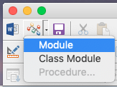
Ex 14: CLANning legacy (Word) transcripts
Open newfile.cha and the Game_Night Word document
Copy and paste the lines of dialogue from Game_Night.doc into CLAN
You’ll notice that all the underlines have disappeared.
To fix this:
Open unicode_underlines.txt and copy it
In Word, Open Tools/Macro/Visual Basic Editor and create a ‘module’
Paste in the contents of unicode_underlines.txt and press the ‘play’ button
Try copying and pasting from Word to CLAN again – now it should work
Clean up the transcript by search/replacing IDs like *MAU: with “Maureen:”

Slide 32
Outline
Approaches to digital transcription
Getting started with CLAN
Getting started with ELAN
Using CLAN and ELAN together
Future tools and directions for digital transcription

Slide 33
Future tools for digital transcription
Automated CA transcription
https://bit.ly/gailbot-talk
Drawing on video, in time
https://saulalbert.net/project/drawing-interactions/
Notes:
11:30-11:40

Slide 34
Question & follow-ups
Thank you for participating in the digital transcription workshop!
All workshop materials and now-to videos will remain online at :
http://saulalbert.net/digital-transcription
Your feedback is very welcome:
http://bit.ly/digital-transcription-feedback
Recap:
Approaches to digital transcription
Getting started with CLAN
More advanced work with CLAN
Getting started with ELAN
Using CLAN and ELAN together
Future tools and directions for digital transcription
Questions/follow-ups

